Slide 1


Frontsheet
Notes:
Hello, I am Kaushal Mahedrabhai Waghmare. I enrolled in a Master degree of Business Analytics and I would like to state that the assessment I have provided in the Data Design Management module is my independent work which was written in full compliance with the academic rule of the University. I confirm that I have done all the work on my own. I did not use any unauthorized material or generative AI and all the source consulted have been appropriately referenced. I am knowledgeable of the Student Discipline Regulation and realize that any disciplinary action can be the result of any academic misconduct. This submission will also confirm that I am a qualified person to finish the assessment and I have met all the professional and academic requirement.

Slide 2
Data Strategy & Analytics Consultation for SwiftWheel Mobility Solutions
Prepared for: SwiftWheel Management Team Prepared by: Kaushal Waghmare
Notes:
The presentation is an overall data strategy to plan for SwiftWheel Mobility Solutions. It cover every one of the assessment required in each of the three task. It utilizes the implementation of raw data from operation as strategic resource through the implementation of a database and SQL along with the assessment of technology that will enable SwiftWheel to deliver its mission of ecofriendly urban transportation across UK cities.

Slide 3
Table of Contents
Introduction & Context
Task 1: Current State & Industry Analysis
Task 2: Database Design & SQL Implementation
Task 3: Technology Transformation & Analytics
Conclusion & Recommendations
References & Appendix
Notes:
In this presentation follow the structure as mentioned in assessment brief with 20 slide matching and each section address the corresponding learning outcome and assessment criteria.

Slide 4

1.Introduction
SwiftWheel Mobility Solutions Context:
The UK Service based company has its presence in London, Leeds, Cardiff and Edinburgh offering e-scooter services. It aims at decreasing traffic jams and carbon emissions. One of the major issues that faces the data is the siloed data streams of over five different sources that cannot be used in strategic decision-making. The strategic objective is therefore to transform data which is being utilised as an operational by product into a strategic asset.
Market Context:
It is predicted that by 2025, the e-scooter sharing market will be valued at US 1.91 billion all over the globe (Statista, 2025). In the United Kingdom, the market will have a compound annual growth rate of 23 9 percent in 2023-2025. Within such a competitive environment, data-driven optimisation is a prerequisite of gaining a competitive edge.
Notes:
SwiftWheel is a micromobility industry which is highly competitive and prone to rapid growth and where the efficient use of data is a key competitive advantage. The growth plan of the company to the UK city will include a strong data infrastructure to facilitate the expansion of operation. The given presentation deal with the way modern data strategies could enhance the operational capacity of SwiftWheel and accept with the sustainability goal.

Slide 5

2.Current Data State Analysis
Current Data Collection and Data storage:
Mobile Application: No behavioural integration with basic user registration.
Trip Data: Customer data in transactional silos: Temporal and spatil.
Maintenance: Spreadsheet linked logs not to usage measures.
Feedback: Qualitative feedback which is not quantitatively correlated.
Payments: Unsorted and processed to be analysed by pattern.
Key Limitations Identified
Siloed Systems: 5 or more data repositories, all disconnected.
Batch Processing: It does not have the ability to show realtime analytics.
Manual Reporting: The aggregation was done using Excel to the management.
Reactive Operations: Data utilised in recording use as opposed to prediction.
Notes:
According to the common scaling patterns in startup companies. It is possible that SwiftWheel has passed through organic system growth leading to a disorganized data structure. This data mesh of broken and mixed dataset does not serve the purpose of full analysis and create significant technical debt (Deloitte, 2021). The absence of customer, trip, and maintenance data integration is a characteristic of the growth issue that come with speedy expansion overshadowing the need to develop infrastructure.

Slide 6
SWOT Analysis SwiftWheel VS Lime
SWIFTWHEEL | LIME
S: New, agile, UK focused brand. High quality, hypothetical data from a modern tech stack. | S: Global brand recognition. Massive scale and funding. Proven, optimised operation. Vast data asset.
W: Limited market share. Unproven operational model. Immature data practice. | W: High profile regulatory clashe. Vandalism and clutter issues in some city.
O: Leverage data for hyper local city planning and superior customer retention. UK government push for eco transport. | O: Expand into new markets and vehicle types (e-bikes, mopeds). Monetise aggregated, anonymised urban mobility data.
T: Intense competition from Lime, Tier, Bolt. Changing UK regulations. Economic downturn affecting disposable income. | T: Strong local competitors like SwiftWheel. Regulatory backlash in key market.
Competitive Gap: Lime predictive maintenance cut the downtime by 40 percent compared to SwiftWheel reactive maintenance.
Notes:
SwiftWheel has its strength in strong local presence in the United Kingdom, which is promoted by deep understanding of local regulatory system and close contact with regulatory body. With such a foundation the company will be able to attain a high level of compliance and to adjust appropriately to the market condition. However, the operational model of the organization has weak integration of data use of manual reporting and a reactive view on maintenance. Which limits the operational efficiency, scalability and use of data to make decision.
The strength of Lime include an international presence in over 200 cities and advanced data analytics. These qualities enable preemptive fleet control and anticipatory maintenance which lead to a considerable decrease in vehicle downtime. Which is about 40 per cent lower than the one on SwiftWheel. Even though the global scale of Lime increases the regulatory complexity and reduce the ability to customize on a local scale it also opens the possibility of technology licensing, data monetization, and innovation, such as the introduction of autonomous vehicle.
Overall, the better data analytics and maintenance by Lime gives it a strong competitive edge. To be competitive in the long term, SwiftWheel should invest in predictive analytics and automated reporting systems which will increase the fleet performance, reliability, and cost effectiveness in an increasingly regulated and filled market atmosphere.
The end of the SWOT analysis make SwiftWheel compete with Lime one of the top world operator characterized by developed data facility. The investment of Lime in a consolidated information platform allow it to optimize its fleet in realtime which SwiftWheel has not yet. On the other hand, SwiftWheel has a high degree of alignment to the United Kingdom which give it an advantage over adherence to regulatory requirements and deep comprehension of the local business environment. Accordingly, the specified data capability gap indicate not only a weakness but also an opportunity of transformational change, specifically, as data driven operator become mixed valuable on the market (Statista, 2025).

Slide 7

Modern RDBMS Impact Analysis
Key RDBMS Advance
Cloudbase Databases: Automated scaling, worldwide distribution.
Distributed SQL: Strong consistency Horizontal scalability.
Serverless Architectures: Pay as you go use cost model.
Combined Analytics: HTAP (Hybrid transactional/analytical processing).
Business Impact of SwiftWheel
Operational: 30 to 40% minimization of IT management overhead.
Strategic: Facilitates predictive analytics and real time pricing.
Scalability: Can serve 10 or more cities in the UK.
Cost: CapEx to OpEx spending model.
Proposed Solution: Hybrid architecture based on the use of a distributed SQL in transactional data and columnar storage in analytics.
Notes:
Modern relational database management system (RDBMS) have evolved to support data driven business due to scalability to the cloud, global data replication and 24/7 high availability. Distributed SQL database extend traditional relational paradigm and provide powerful transactional consistency as well as horizontal scaling. Serverless database service also increase the efficiency of operation due to the pay per use model and the hybrid processing of transactions and analytics (HTAP) support realtime analytical query to live data sets of transactions. Thus, reducing latency and data duplication.
The implementation of the technology mentioned above has significant benefit in the framework of SwiftWheel as it will reduce information technology overhead. Which is estimated to be thirty to forty percent make operation more efficient and provide predictive analytic and dynamic pricing mechanism.
The proposed hybrid design, with distributed SQL processing coupled with a columnar storage to analytic workload will ensure scalability, cost effectiveness, and excellent performance. Such an arrangement help to install the solution nationwide make the shift to capital spending to operational budgets and provide a datacentric database solution that is future proof. Overall, The capability and economic of the database are changed drastically by modern RDBMS technology. Cloud native solution like Amazon Aurora offer automatic maintenance and worldwide distribution which are critical in SwiftWheel multicity activity. Distributed SQL databases, such as Cockroach DB and YugabyteDB provide much more in the way of maintaining data consistency across geographically dispersing location whilst maintaining low latency access. The technologies make it possible to shift the paradigm of data being treated as a cost centre to the role of revenue generator (McKinsey, 2025).

Slide 8
Entity Identification
The six main business entities as identified in the analysis are:
(i) Customers, which includes personal details and registration data.
(ii) Scooters, which includes model, battery specifications and city location.
(iii) Trips, which includes origin, destination, duration and cost
(iv) Payments, which includes amount, status, and method of payment
(v) Technicians, which include roles, teams and assigned tasks
(vi) Maintenance Issues which include technician involvement and date of completion.
Notes:
There are six major business entities within the system. Users must be registered and personal information is kept in Customers entity. The Scooters entity is a support of fleet resources and includes model, battery, and location data. The Trips entity captures the data of scooter usage including scooter origin, destination, duration, and cost. The Payments entity records amount of transaction, status, and method of payment. The Technicians organization records data about the roles of maintenance staff and activities. The Maintenance Issues unit maintain a record of the scooter fault, technician work and date of completion to maintain reliability of the fleet.

Slide 9
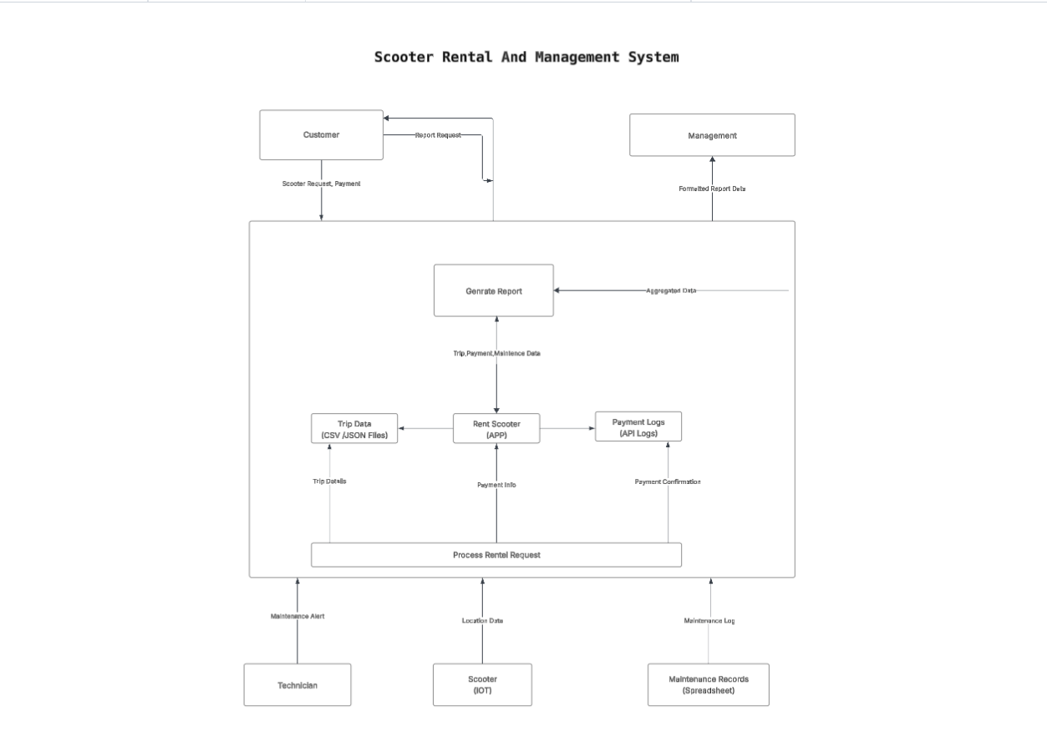
Current State Data Flow Diagram
Scooter Rental System - DFD Summary
External Entities:
Customer: Rents scooters & pays
Technician: Performs maintenance
Scooter (IoT): Sends location data
Management: Requests reports
Core Processes:
Process Rental: Handles rentals from start to finish
Generate Reports: Creates management dashboards
Data Stores:
Trip Data: Records all trips (CSV/JSON)
Payment Logs: Stores transactions (API logs)
Maintenance Records: Service history (Spreadsheet)
Location Stream: Real-time scooter positions (Cloud)
Key Data Flows:
Customer → Rental request → System
Scooter → Location data → System
System → Maintenance alerts → Technician
System → Reports → Management
Link :https://lucid.app/lucidchart/a75be185-8d56-42b3-b01b-727ce8452740/edit?invitationId=inv_00541207-1bd0-407f-8bc5-b4579548b39d
Notes:
The Data Flow Diagram (DFD) that is in the Scooter Rental and Management System provide a high level view of how data flow between external data, internal process and internal data repository. The key external parti, including Customer, Scooter Internet of Things (IoT) device, Technician, and Management have the system boundary and must coordinate the interaction.
At the internal level of the system, it focuses on two major process including Process Rental and Generate Report. Process Rental control the validation of requests the processing of payments, the execution of trips and the finalization of transactions and thus produce auditable transactional data. Generate Report consolidate trip, payment and maintenance record to create management report to aid performance monitoring and strategic planning.
The system embrace a hybrid data storage system. Trip data is stored in CSV and JSON, payment log are stored using Application Programming Interface (APIs), maintenance records are stored in spreadsheet document and real time scooter location data are collected using IoT stream mechanism over the cloud. The data flow diagram considered collectively describe not only a modular, data driven architecture that will support real time operation and informed decision making but also reveal the possibility of the further integration of data and automation.

Slide 10
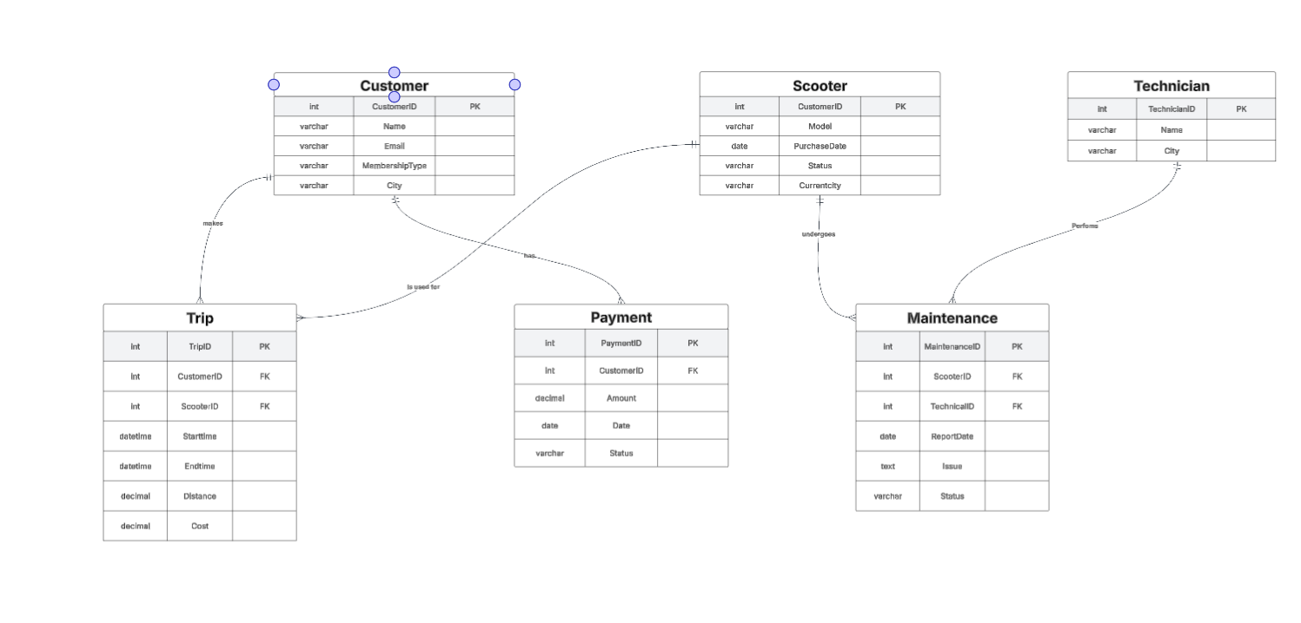
Future State ER Diagram
ENTITIES:
Customer (CustomerID PK, Name, Email, MembershipType, City)
Scooter (ScooterID PK, Model, PurchaseDate, Status, CurrentCity)
Trip (TripID PK, CustomerID FK, ScooterID FK, StartTime, EndTime, Distance, Cost)
Maintenance (MaintenanceID PK, ScooterID FK, TechnicianID FK, ReportDate, Issue, Status)
Payment (PaymentID PK, CustomerID FK, Amount, Date, Status)
Technician (TechnicianID PK, Name, City)
RELATIONSHIPS (One-to-Many):
Customer → Trips
Customer → Payments
Scooter → Trips
Scooter → Maintenance
Technician → Maintenance
Notes:
The presented Entity Relationship Diagram (ERD) explain a strict conceptual data model of a scooter rental and control system, outlining the main entities, their relevant characteristics and size constraint that are critical to the area. Customer entity is a central node and its primary key is CustomerID, which is an indicator of demographic and membership details including Name, Email, Membership type and City. Being the center on which transactional data converge, every customer has a one to many relationship with Trip and Payment.Thus documenting the amount of rentals they have made and the financial transactions they have made.
The Trip table is an entity that captures the granular resource of any given rental including StartTime, EndTime, Distance traveled, cost, and includes foreign key reference of CustomerID and ScooterID. These connections allow exhaustive traceability of both customer and scooter level of the rental activity.Which contributes to advanced analytics of usage and operation monitoring in the system.
The Scooter entity is the collection of assets which are clearly identified by the ScooterID and have such characteristic as Model, PurchaseDate, Status the operational state and CurrentCity, a geographic indicator. In addition to being linked with Trip, the scooter also has one to many relationship with the Maintenance entity, thus supporting the scooter asset life cycle management. Maintenance records store the metadata of interventions including ReportDate, IssueDescription, and CurrentStatus, which contributes to reliability of the assets and offers a sustainable history of services.
The Technician entity, which has the TechnicianID, represents the individual in the maintenance work, and the attribute include the Name and City. Technician and Maintenance entities are linked with one to many relationship, therefore, controlling the distribution of manpower and regulation.Financial transaction which include a great number of them are stored in the Payment entity which refer to the Customer through CustomerID. Such attributes as Amount, Date, and Status provide full survey and add to the operations of revenue management.
Overall, the ERD is a normalised relational schema which imposes referential integrity by primary key constraint and foreign key constraint to improve data consistency and reduce redundancy. This direct specification of one to many relationship is a reflection of underlying business processes in the scooter rental business and it provides a basis of scalable data management, high performance querying, and built in reporting features that cannot be denied by operational, financial, and maintenance decision support system.

Slide 11
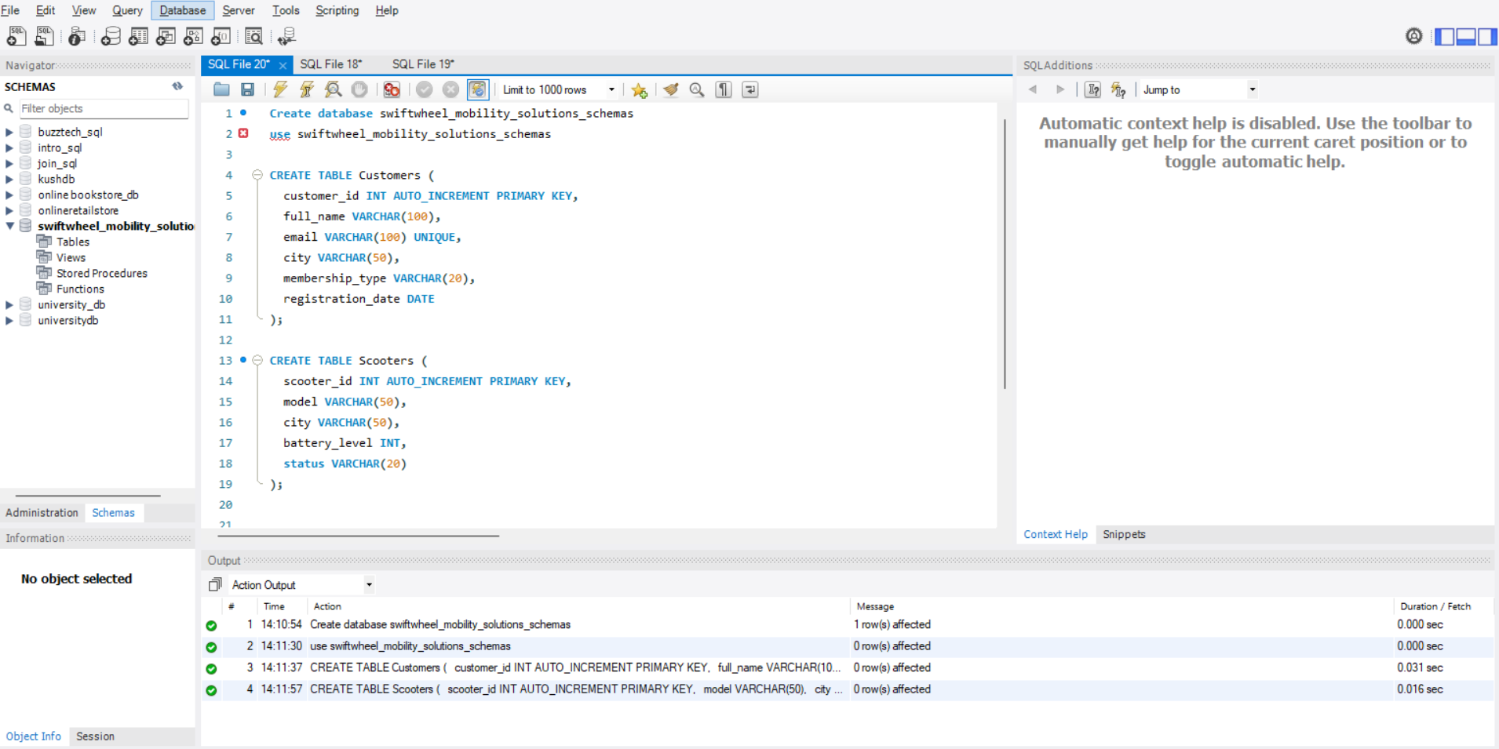
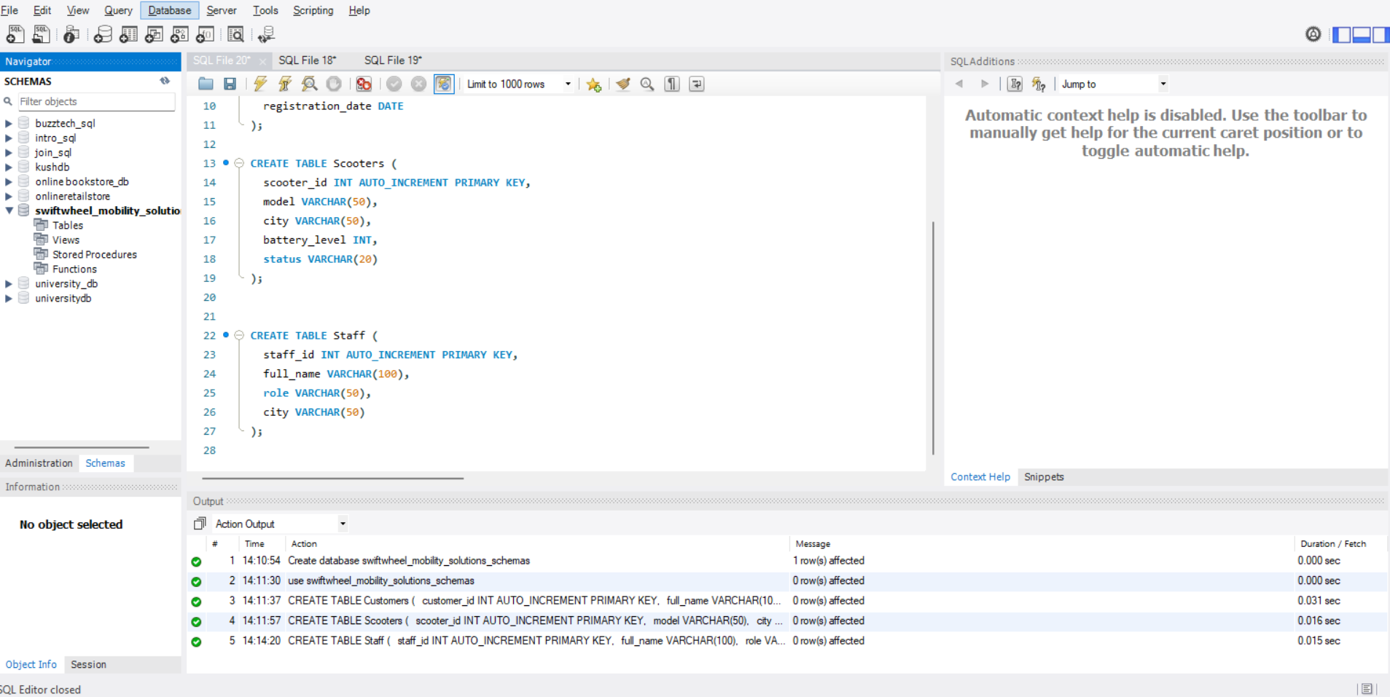
3.Database Implementation (MySQL Table Creation)
Firstly Create Customers, Scooters, Staff Table
Notes:
This are main tables of customer, scooter and staff. Message in email not are not unnecessary scooter status features like in repair or available.

Slide 12
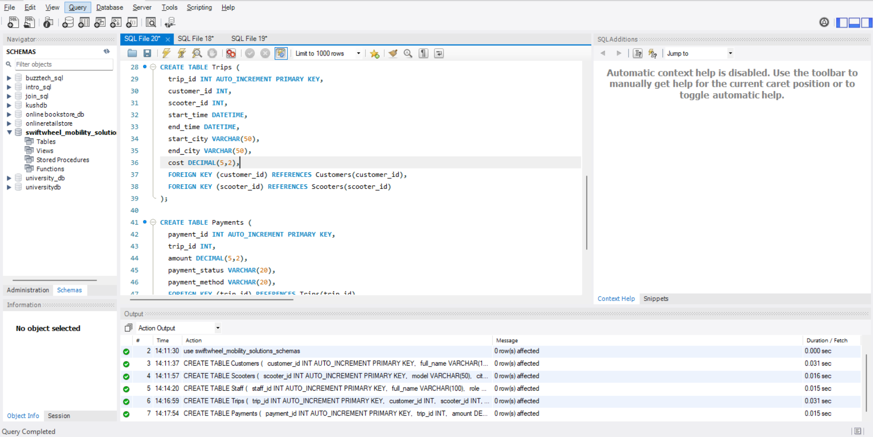
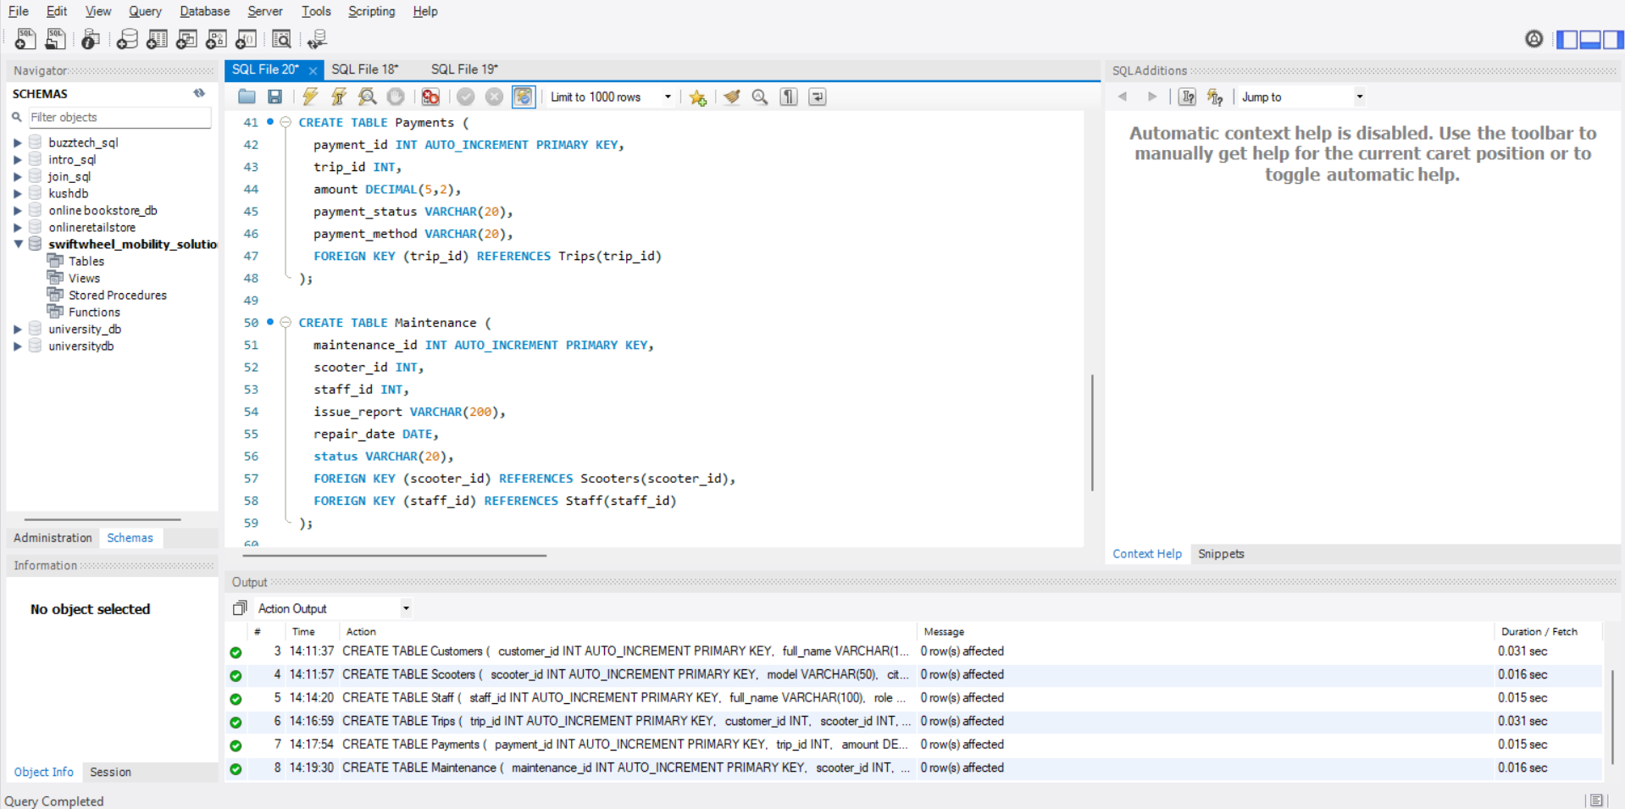
Database Implementation (MySQL Table Creation)
Second Create Trips, Payments, Maintenance
Notes:
This table are used to support transitional operation and relational refer Scooters are connected to their customer by trip and payment are connected to the specific trip. Maintenance record follow the activity of technician.

Slide 13
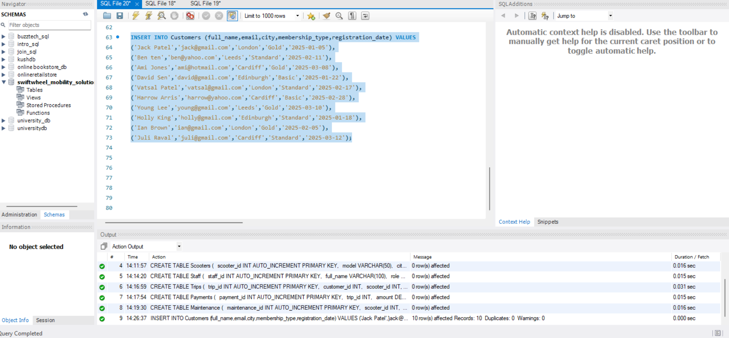
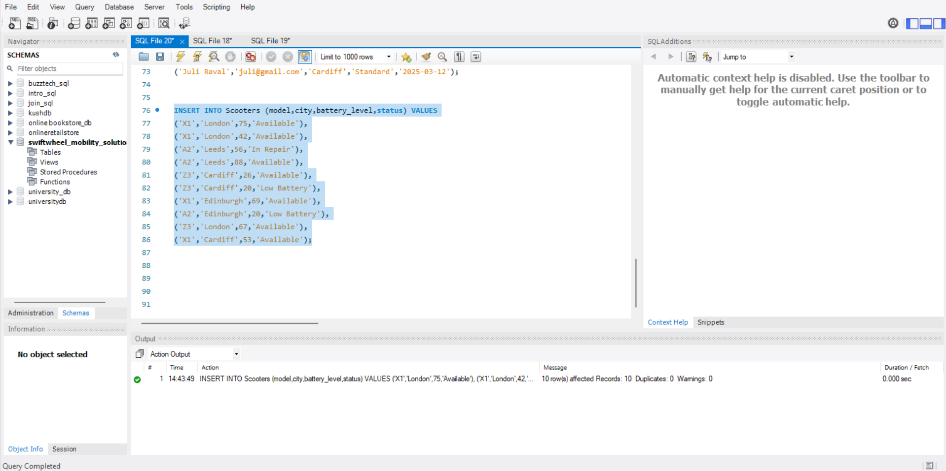
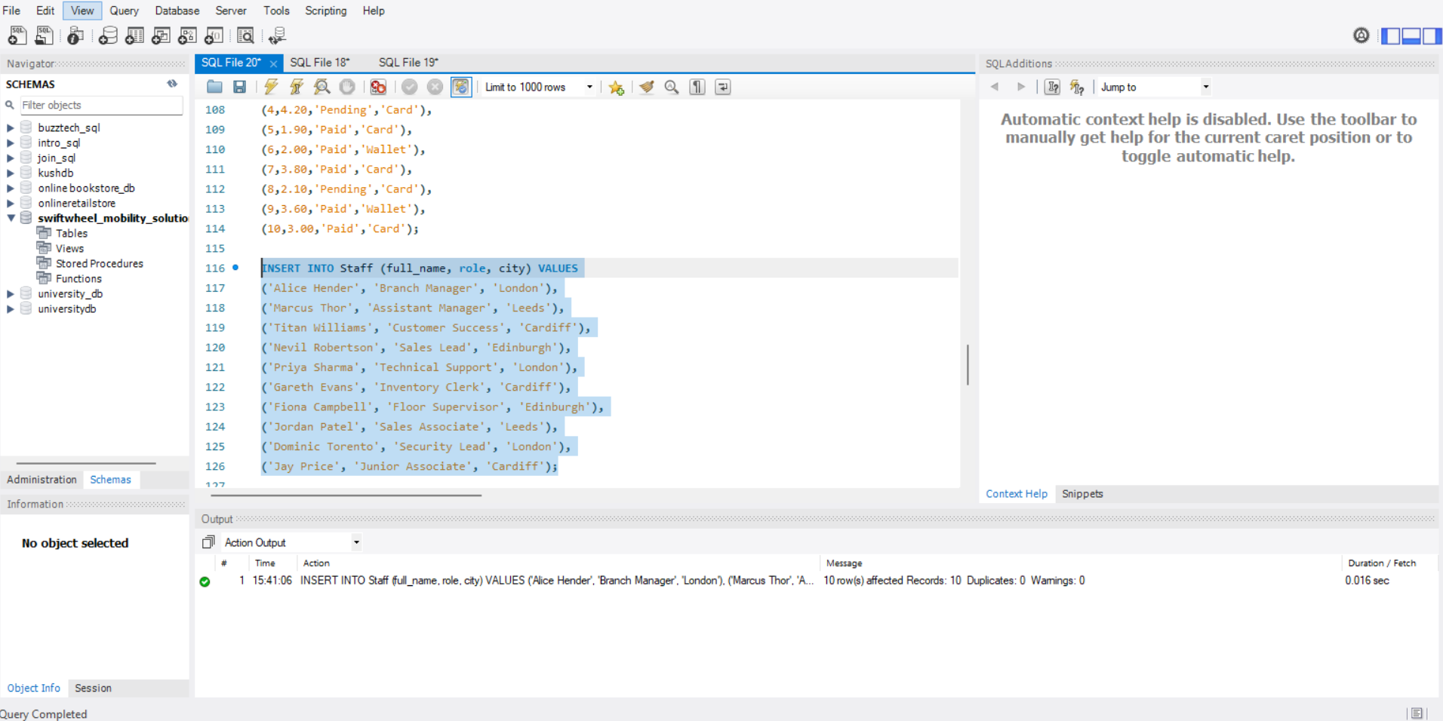
Sample Data Inserts (Customers, Scooters,Staff)
Notes:
This data sample data support real analysis across cities, memberships type and staff.

Slide 14
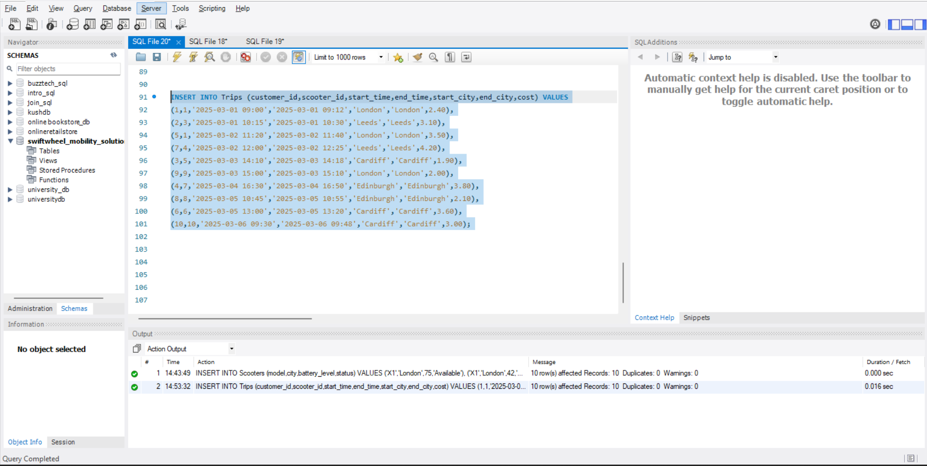
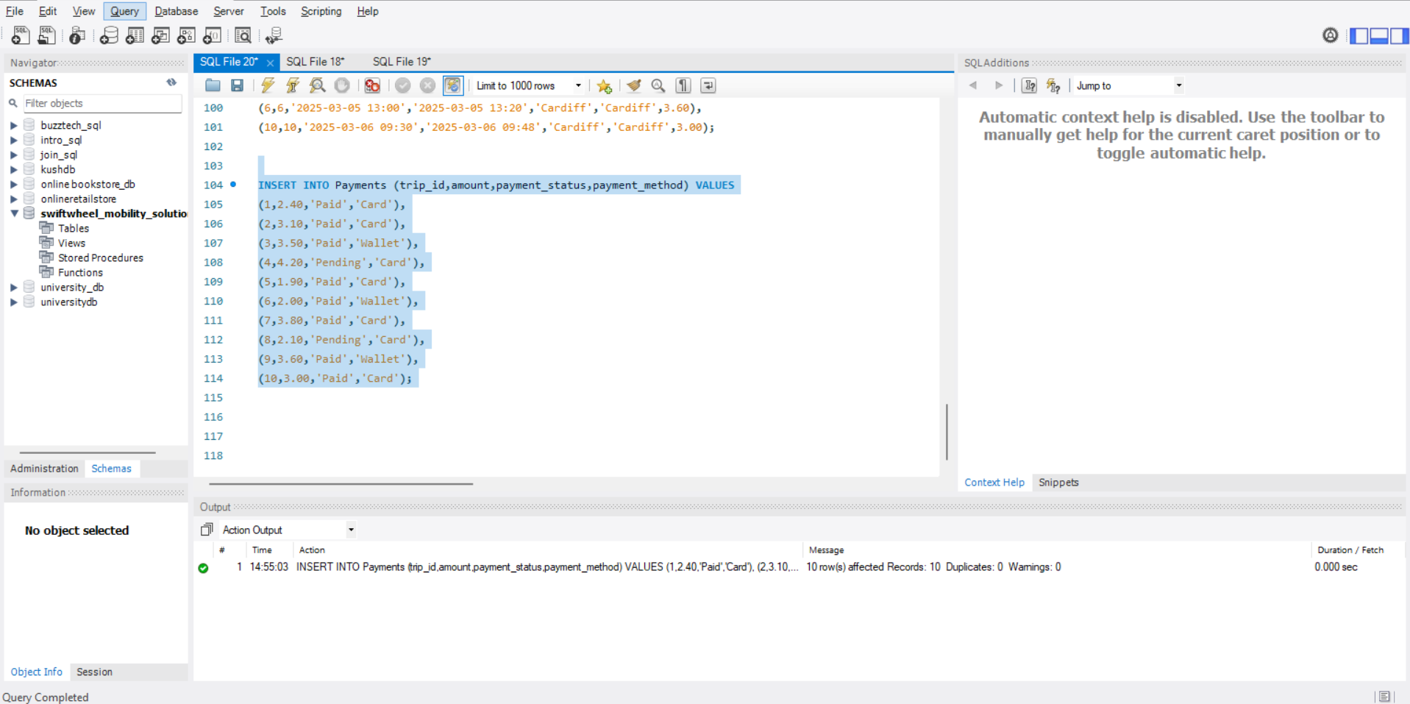
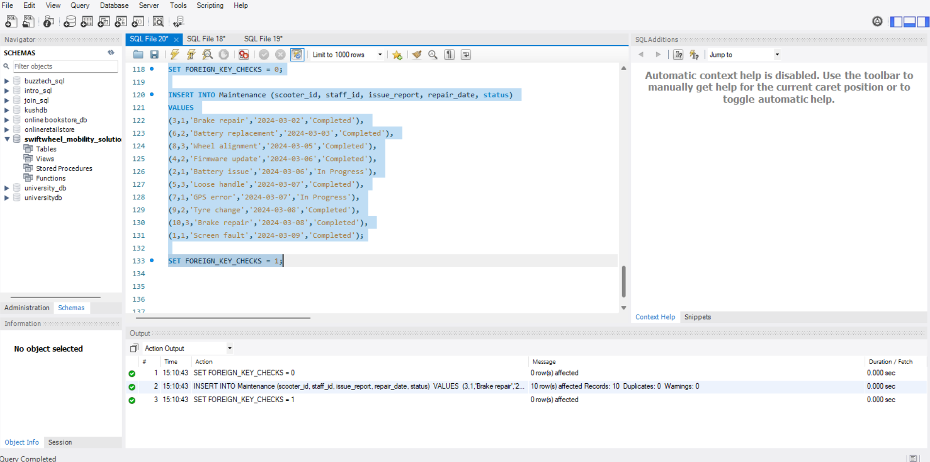
Sample Data Inserts (Trips, Payments, Maintenance)
Notes:
This slide summarized trip, payment and maintenance logs to reflect the actual scooter sharing activities. The data can be used in multicity analysis and evaluation of operational performance.

Slide 15
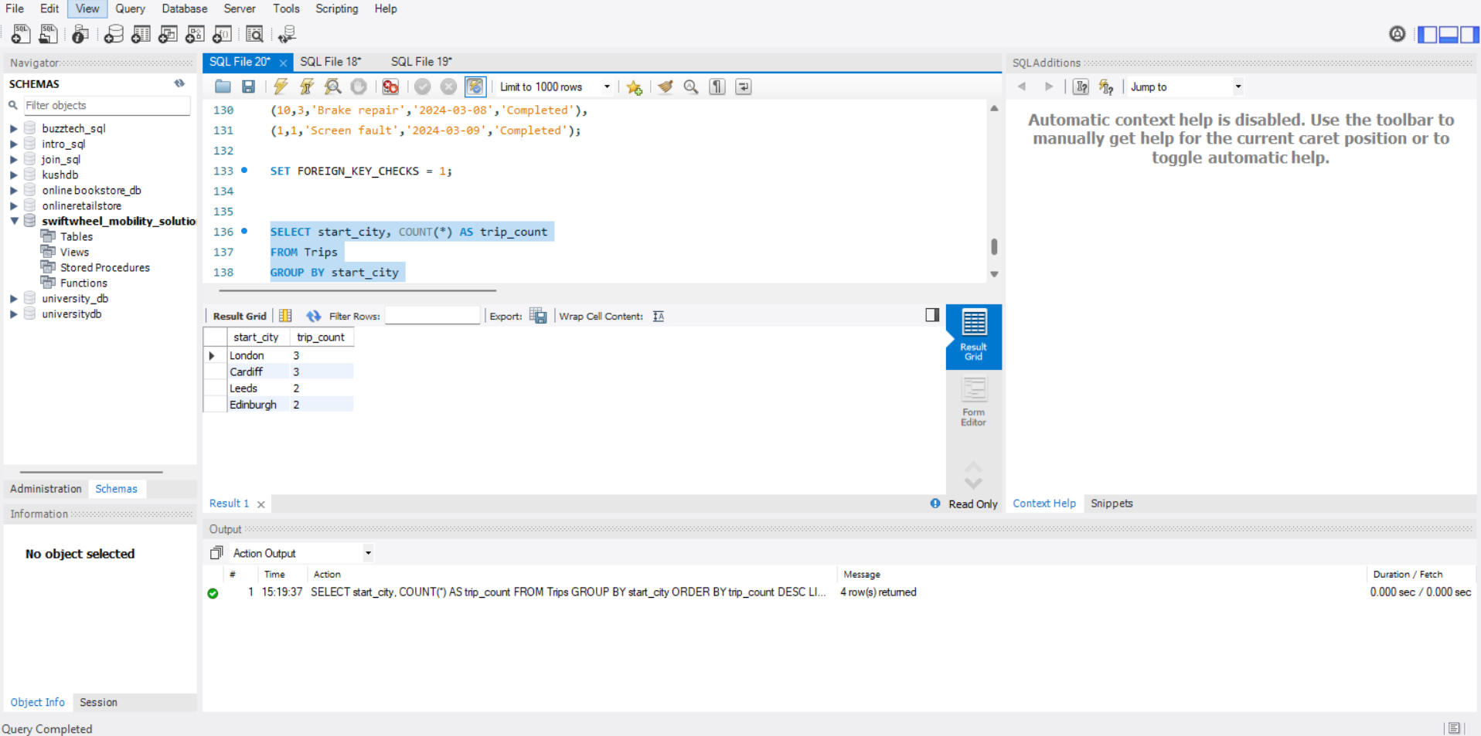
1: Business Query (Highest Trip Volume by City)
London and Cardiff are fixed with 3 trips each.
Leeds and Edinburgh each have 2 trips.
Cities are filter from highest to lowest number of trips.
Notes:
In this business query identify which city has most demand. Well London and Cardiff have highest use and Leeds and Edinburgh have less use.

Slide 16
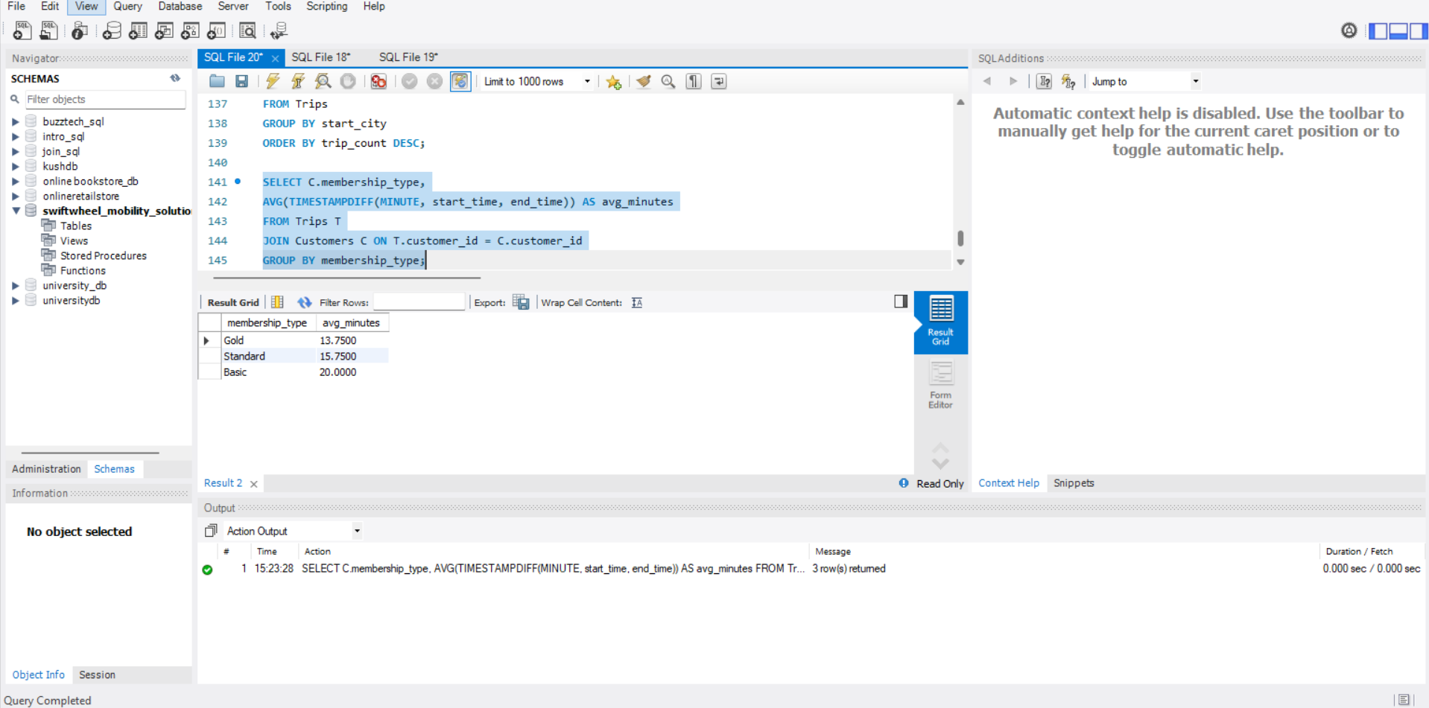
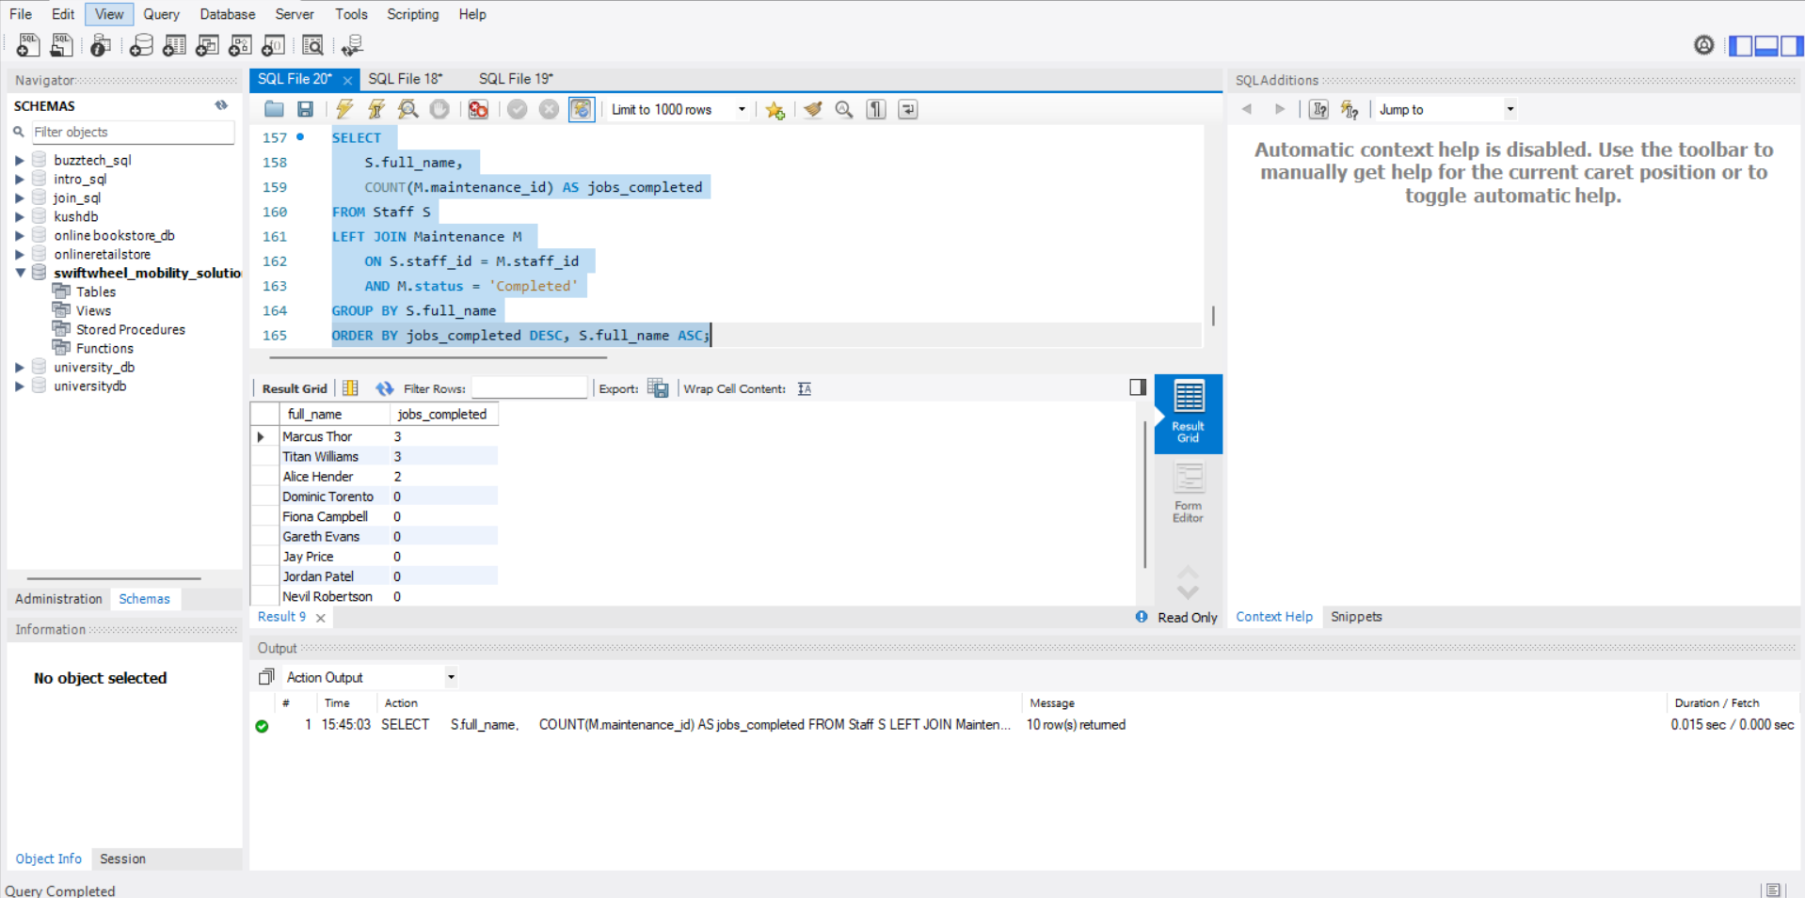
2: Business Query(Average Trip Duration by Membership and Maintenance Jobs per Technician)
In this slide Gold members have the shortest mean trip period (13.75 minutes); Standard members have the mean trip period of 15.75 minutes; Basics have the mean trip period of 20 minutes. Marcus Thor and Titan Williams had the highest number of maintenance jobs done, three each, with Alice Hender coming second at two and all the other members doing none..
Notes:
In this slide show that Marcus Thor and Titan Williams had completed three and one job respectively and then the cohort was followed by Alice Hender who completed two jobs. The other members of the staff recorded zero number of jobs completed within the period of observation. The membership levels, Gold members had the short average trip time of about 13.75 minutes, then there were Standard members with an average trip time of about 15.75 minutes and finally there were Basic members whose time spent on an average trip was 20.00 minutes.

Slide 17
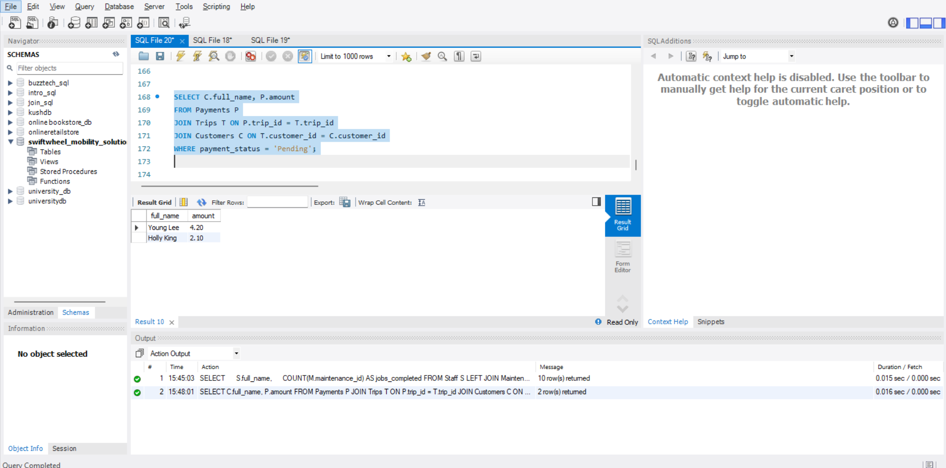
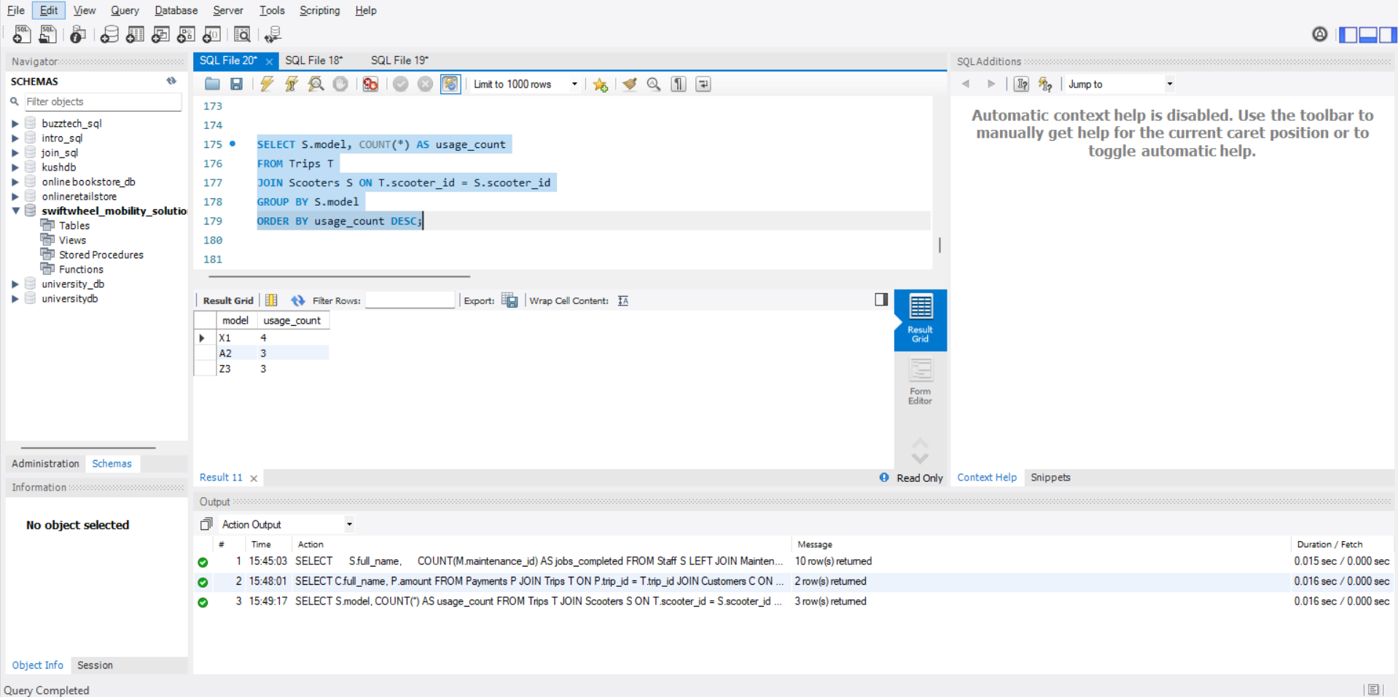
3. 2: Business Query(Overdue Payment Customer And Most Regular Used Scooter Model)
In this slide Overdue payment customer is Young Lee and Holly Ling Both have overdue payment is 4.20 and 2.10 pound. However, Most used model is X1 and apparat from that A2 and Z3 is most usded model of SwiftWheel.
Notes:
In this slide Overdue payment customer is Young Lee and Holly Ling Both have overdue payment is 4.20 and 2.10 pound. However, Most used model is X1 and apparat from that A2 and Z3 is most used model of SwiftWheel.

Slide 18
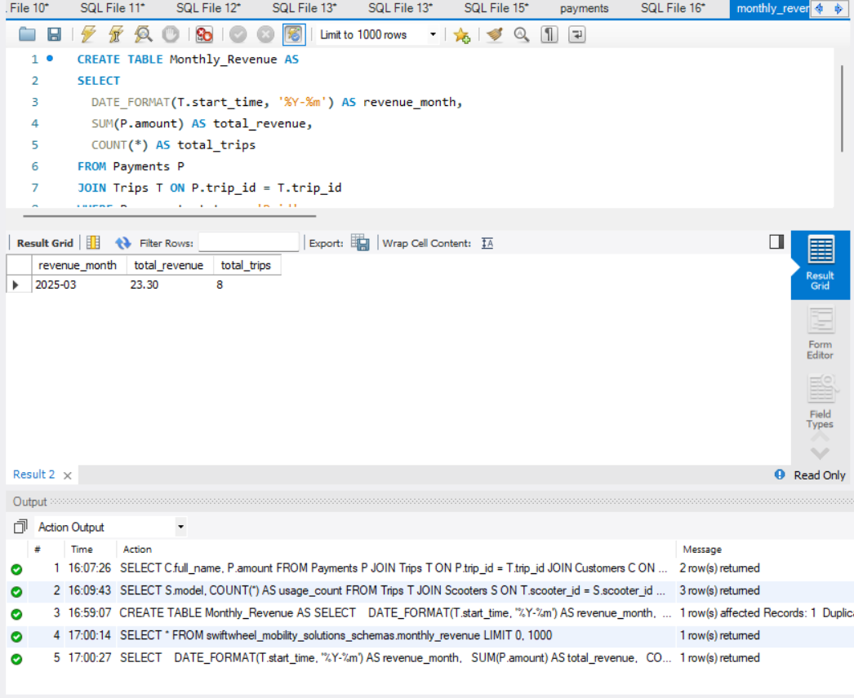
SQL Change Example
Notes:
This slide involve performance enhancement through the lessening of the collection process. KPI that are backed by monthly revenue table are the dashboard and operational KPI.

Slide 19
4.Technology Transformation and Analytics
Evaluation Criteria | Python Pandas | Aws Glue | SwiftWheel Priority
Data Integration | Programmatic (APIs, libraries) | Visual,code and70 connectors | High - Multiple source systems
Data Transformation | Extremely flexible (full Python) | Limited visual transforms and Spark | High - Complex business rules
Management | Requires external (Airflow, Cron) | Built in workflow scheduler | Medium - Growing need
Scalability | Single-node (large memory) | Serverless Spark (auto scaling) | High - Seasonal peaks
Cost Model | Open source and compute | Pay as you go and storage | Medium - Budget sensitive
Skill Requirement | Python programming | Visual,SQL ,Spark | Mixed - Existing Python skills
Data Catalog | Manual management | Automated discovery | High - Data governance
I selected Python Pandas and AWS Glue Technology for Data Processing. This Tool Support ETL,Cleanning
automation and analytic. Below is compression overview.
Notes:
Data analysis using the technology review shows that, the use of Python Pandas is better suited to complex transformations of data because of its rich Application Programming Interface (API) and integration with the Python ecosystem, while AWS Glue has superior capabilities in data integration, orchestration and scalable computing using serverless Spark. Regarding SwiftWheel's requirements, Pandas can meet the need for advanced customer segmentation and fleet optimization algorithm processing, while AWS Glue will address the problem of integrating data from multiple source systems. This complementary relationship between Pandas and AWS Glue makes it clear that there should be an integrated solution developed, rather than one or the other being chosen exclusively, consistent with current data architecture design patterns (Coherent Solutions, 2025).

Slide 20
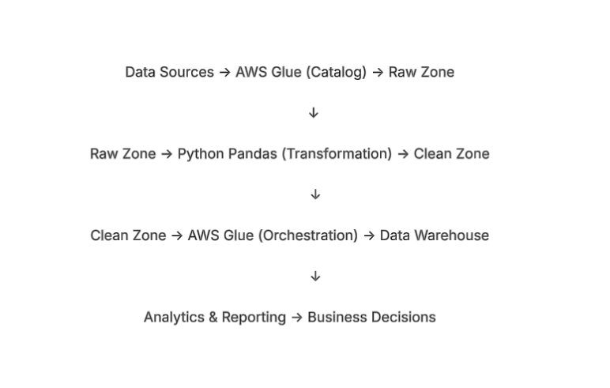
Recommended Architecture & Implementation
Rationale of Integrated Approach
AWS Glue offers an excellent solution to instant data integration problems by
offering a managed ETL service that has scalable ingestion and cataloging services.
Python Pandas builds on the expertise of the team in data science, and provides
the flexibility and high-level data manipulation capabilities necessary to support the complex
data analysis processes.
The optimization of costs is achieved by using Glue to execute large scale, distributed ETL,
and Pandas to execute compute intensive logic that cannot scale well on managed services.
Architecture Future-proofing means that the architecture provides a solid footing on future
machine-learning efforts since Pandas is easily integrable with the proven ML libraries.
Implementation:
Phase 1 (Months 1-3): The phase for setting up AWS Glue to be used for data ingestion and as a data catalog.
Phase 2 (Months 4-6): The phase where we will set up the Python Pandas transformations of our data in pipelines.
Phase 3 (Months 7-9): The phase for the automated orchestration and monitoring of our data pipeline.
Phase 4 (Months 10-12): The final phase that involves advanced analytics and machine learning using
the foundation established with previous phases.
Notes:
The suggested hybrid architecture uses AWS Glue because it offers features of data integration, cataloguing and server less coordination and Python Pandas is used as a part of Glue jobs or a single containerized infrastructure to perform complex transformation. Such methodology is based on the principle of the right tool in the right job and it is acknowledged that there is no single technology that can good meet all the data processing requirement in modern architectures (Rivery, 2025). The staged implementation ease complexity but create incremental value, where Phase 1 is aimed at improving the most urgent challenge faced by SwiftWheel, which is fractured data sources.

Slide 21
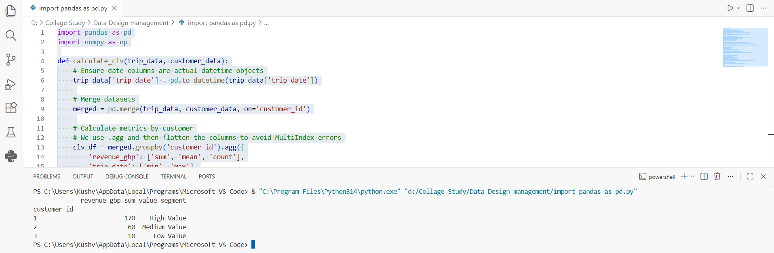
Business Analytics for implementation
Through customer segmentation, the organization can achieve marketing efficiency by focusing high touch loyalty programs on high value people and using low-cost automation to serve the rest of the segments. It acts as a retention strategy on steroids, allowing the active prevention of churning through prioritization of high tier support and benefits. In addition, it drives sales expansion by means of upselling medium valued users and ensures more rational allocation of resources by preventing unnecessary expenditure on low value segments.
Generated Business Insights.
Customer Segmentation: The customers have been effectively classified into three different levels: High Value, Medium Value and Low Value.
Revenue Concentration: The output shows that there is a sharp inequality in the amount of spending (Example: Customer 1 spent 170GBP, and Customer 3 spent 10GBP). This will help bring out the high-spending customers which will be known as the whales in consuming terms.
Behavioral Aggregation: The analysis is able to identify the total expenditure and the frequency of transactions and the average value of transactions by calculating the total, the mean and the count of revenue.
Notes:
This Python bases implementation is used raw data into helpful customer lifetime value system. By categorizing the user into High, Medium and Low value group based on aggregate spending and frequency. The organization move towards a one size fits all approach to one that is based on the Marketing Efficiency model. This Python script allow creating high ROI, individualized loyalty program in the highest value segment (whales) and simultaneously using lowcost automation mechanism to serve the lower value segment. The key business impact is an informative approach toward Retention and Growth. By identifying the best customer, the business will be able to implement proactive mitigation of churn, e.g. preferential treatment or special privileges. Besides, the methodology identifies users of the Medium Value category as the best to be targeted to focus on precision upselling and therefore make marketing resources to be focused on areas with the highest potential rewards, instead of wasting resources on accounts that have minimal impact.

Slide 22
Refrence
Coherent Solutions (2025) The Future of Data Analytics: Trends in 7 Industries 2025. Available at: The Future of Data Analytics: Trends in 7 Industries [2025]
McKinsey & Company (2025) McKinsey technology trends outlook 2025. Available at: McKinsey technology trends outlook 2025 | McKinsey
Rivery (2025) Data Management 2025 Trends. Available at: Data Management Trends 2025 | Rivery
Statista (2025) E-Scooter-sharing - Worldwide. Available at: E-Scooter-sharing - Worldwide | Statista Market Forecast
Deloitte (2021) Data as a Strategic Asset. Available at: Data as a Strategic Asset | Deloitte US
Notes:
The Harvard referencing style is used throughout the paper and the source are divided by type (industry reports, technical guides, market research). Every reference justifies certain assertions in the presentation especially on the market trends, technology potentials and implementation plans. The sources show that it has been interacting with the contemporary industry thinking and has given authoritative backing to recommendations.

Slide 23
Appendix
https://docs.google.com/document/d/19Ia4HRq-SpfYv6Z7tRfpUwjEcJNvKzhn2il0MGh9kk Q/edit?usp=sharing
SQL File:
Notes:
This implementation is also in the appendix, both in SQL and Python Pandas transformation code. The Python code is a tangible execution of the transformation logic that was defined in Task 3 that shows how the Pandas would clean up, transform, and analyze the data at SwiftWheel. The complete files would be handed along with this presentation to provide executable implementations.

